Slide 1




ViralScope
CS513 - Knowledge Discovery and Data Mining
Fall 2025
Sai Bhavesh Karnam
Jash Anish Mehta
Engin Deniz Dogu

Slide 2
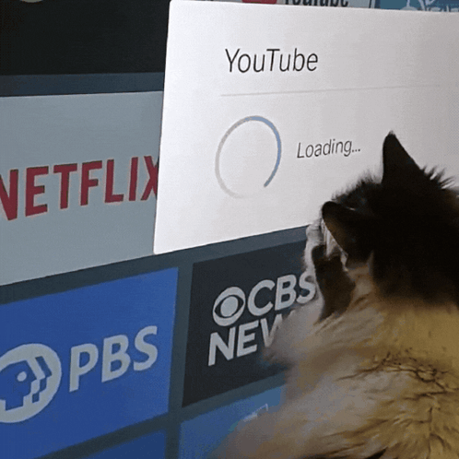
Predictive Modeling of YouTube Video Success
ViralScope is a machine learning project that predicts YouTube video success using metadata and channel characteristics.
The project samples from 85+ million video records across the YouNiverse dataset to identify patterns that distinguish successful videos from others.

Slide 3

Problem Statement
YouTube creators face significant uncertainty in predicting whether a newly uploaded video will attract high engagement. Traditional metrics such as views or subscriber count fail to reliably forecast success, especially due to rapidly changing audience behavior and content trends. This project aims to develop a machine learning model capable of accurately predicting video success.

Slide 4
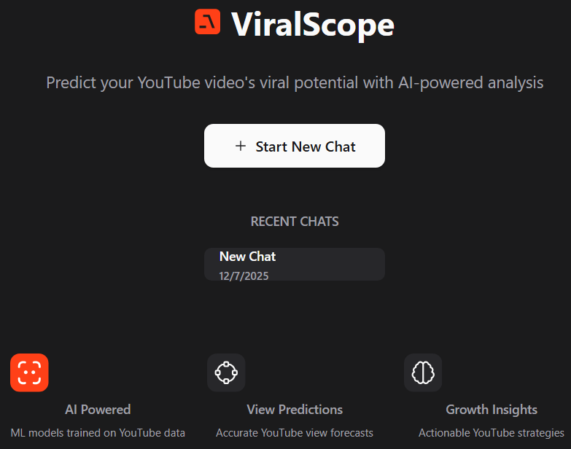
The Application
By analyzing patterns in titles, keywords, upload timing, and channel momentum, the model seeks to provide creators with actionable insights that reduce guesswork and support data-driven content strategy.
Notes:
It is defined as achieving top-tier engagement, using a balanced dataset of video metadata, keyword features, and channel attributes. By analyzing patterns in titles, keywords, upload timing, and channel momentum, the model seeks to provide creators with actionable insights that reduce guesswork and support data-driven content strategy.
ViralScope is a machine learning–powered application that predicts whether a YouTube video will become successful based on its title, keywords, upload timing, and channel metrics. It helps creators make data-driven decisions before publishing by estimating engagement potential and highlighting the factors that most influence video performance.

Slide 5
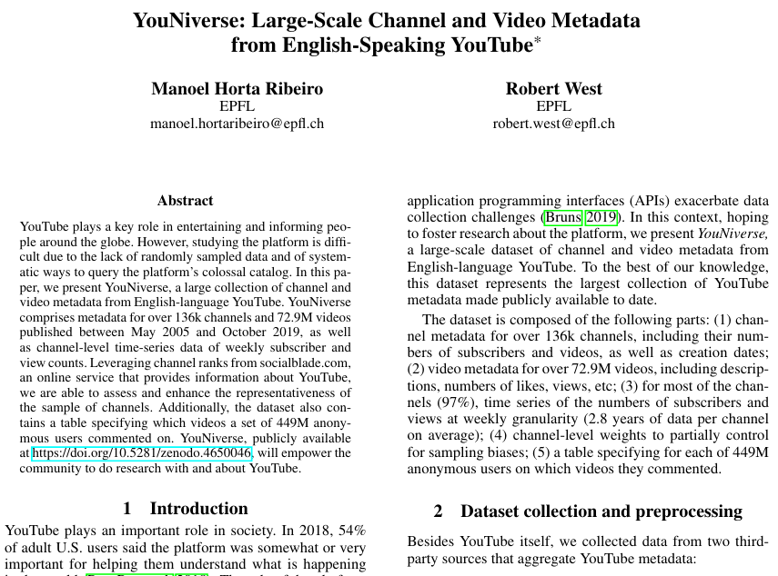
Data
YouNiverse, a large collection of channel and video metadata YouTube. It comprises metadata for over 136K channels and 85M videos.
Covers content published between May 2005 and October 2019
Feature distributions (e.g., views, subscribers) are highly skewed before preprocessing
Notes:
"The foundation of our work is the YouNiverse dataset, which is a massive collection of channel and video metadata scraped from English-speaking YouTube. This is a truly large-scale dataset, covering over 136,000 channels and nearly 85 million videos."
"The dataset was meticulously curated and introduced in an article titled 'YouNiverse: Large-Scale Channel and Video Metadata from English-Speaking YouTube.' It was authored by Manoel Horta Ribeiro and Robert West from EPFL and presented at a top venue, the ICWSM conference."
"Crucially, the data spans content published from the very early days of YouTube, starting in May 2005 and extending all the way up to October 2019, giving us a comprehensive historical view of the platform."
"A key characteristic we must understand is that, like most real-world social media data, the feature distributions—things like views or subscriber counts—are highly skewed before any preprocessing. This reflects the intense popularity inequality on YouTube, where a tiny fraction of content gets the vast majority of attention. Addressing this inherent bias is a critical component of our analysis."

Slide 6
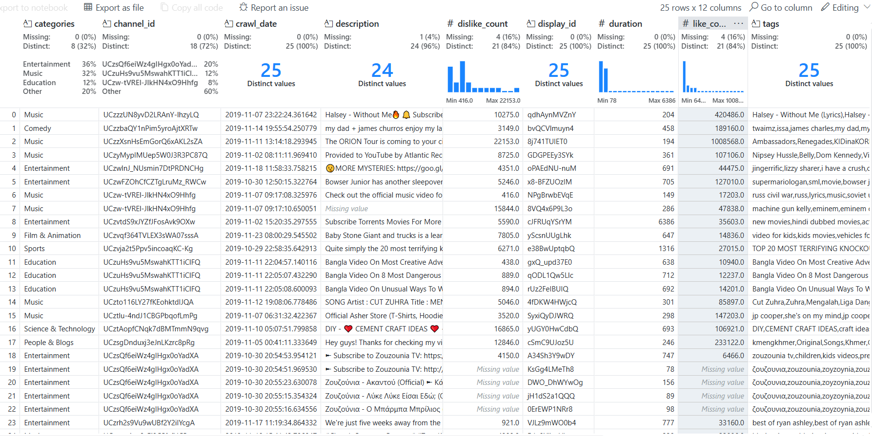
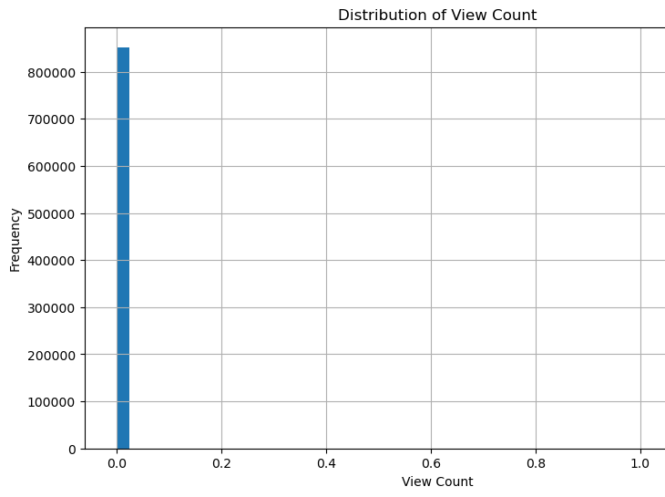
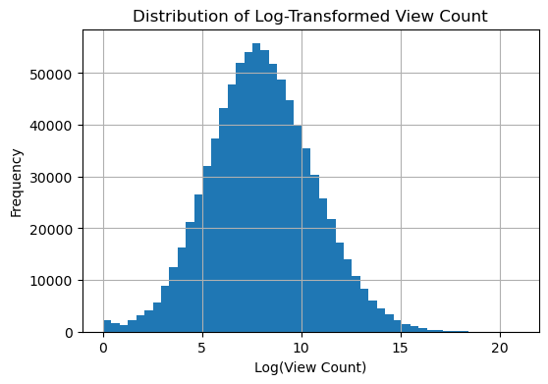
Data

Slide 7
Data

Slide 8
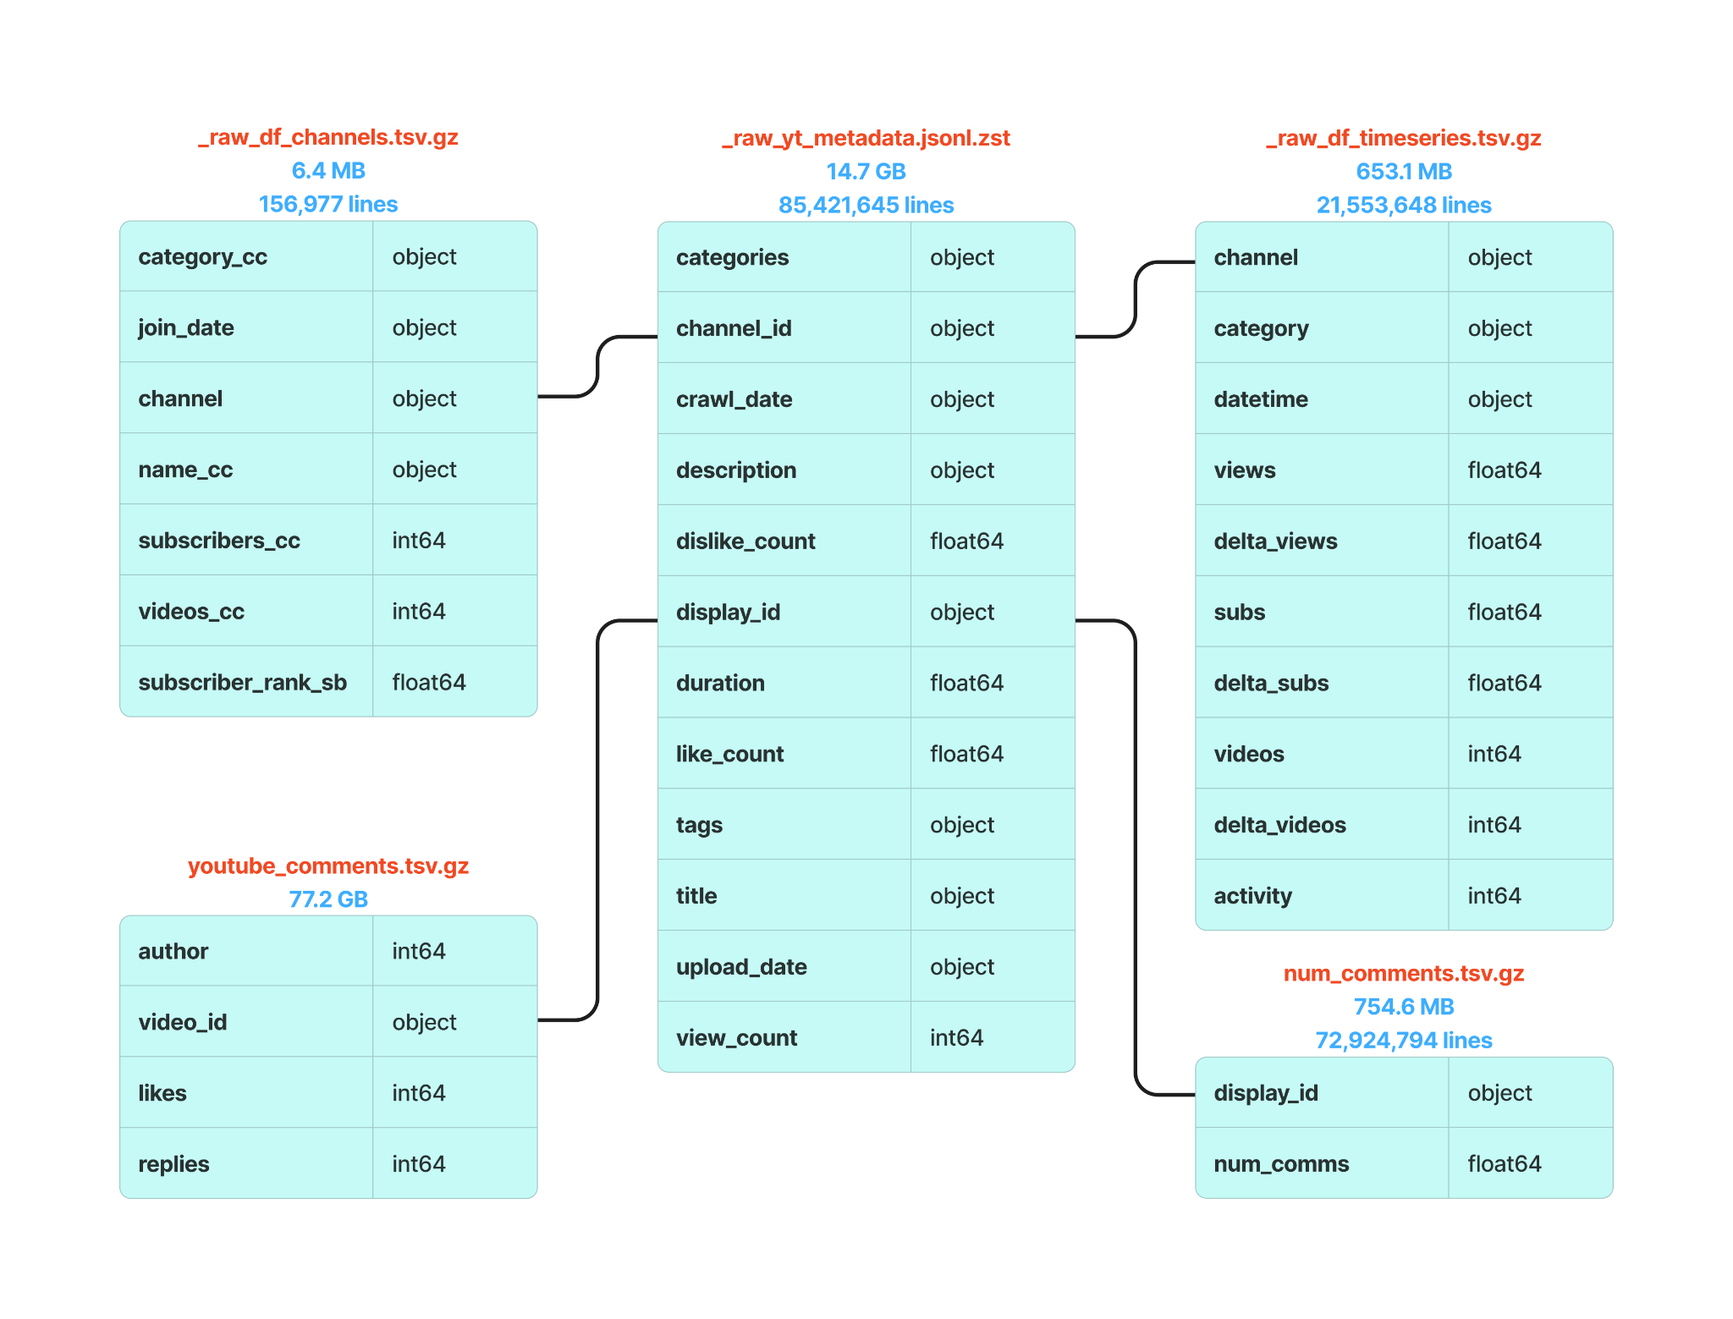
ER Diagram

Slide 9
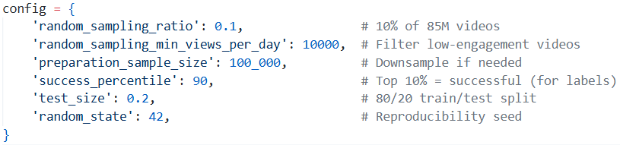
Pipeline
Step 1
Random sampling
from metadata
Step 2
Data preparation: Merge sources and calculate engagement metrics
Step 3
Feature engineering and train/test split with scaling
Step 4
Model training with label creation and hyperparameter tuning

Slide 10
Step 1: Random Sampling
Key Features:
Memory-efficient streaming from Zstandard-compressed files
Two-pass approach: count rows (hardcoded to 85M), then sample
Early stopping when target sample size is reached
Filters videos with minimum views per day threshold (default: 10 views/day)
Handles 85+ million records without loading into memory
Algorithm:
Bernoulli sampling: Each row independently selected with probability `ratio`
Engagement filtering: Calculates `views_per_day = view_count / days_since_upload`
Excludes videos with invalid dates or below engagement threshold
Expected output: ~850K videos (1% of 85M) after filtering
Notes:
Purpose: Samples from the massive 14.7 GB compressed JSONL file using Bernoulli sampling with engagement-based filtering.

Slide 11
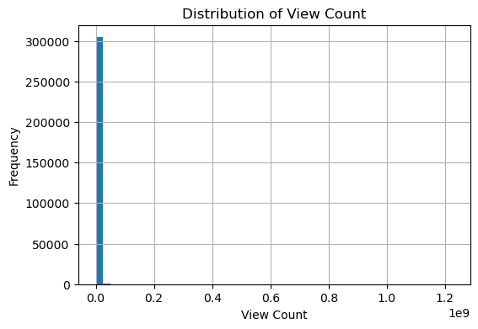
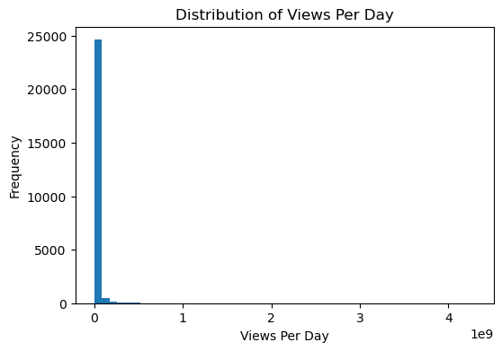
Filtering Low Engagement Videos
Sampled 1% of the dataset with threshold <10
Sampled 10% of the dataset with threshold <10000
Notes:
Purpose: Samples from the massive 14.7 GB compressed JSONL file using Bernoulli sampling with engagement-based filtering.

Slide 12
Filtering Low Engagement Videos
Sampled 1% of the dataset with threshold <10
Sampled 10% of the dataset with threshold <10000
Notes:
Purpose: Samples from the massive 14.7 GB compressed JSONL file using Bernoulli sampling with engagement-based filtering.

Slide 13
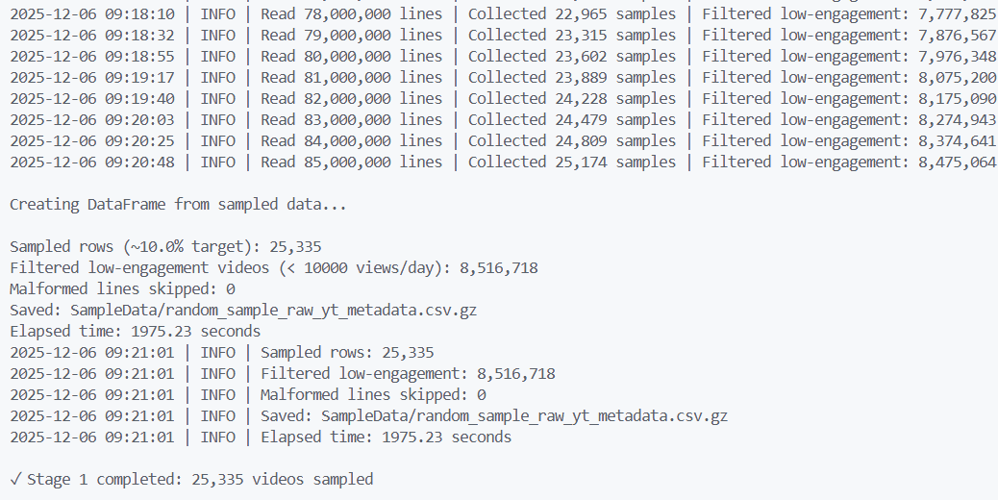
Notes:
Purpose: Samples from the massive 14.7 GB compressed JSONL file using Bernoulli sampling with engagement-based filtering.

Slide 14
Step 2: Data Preparation
Key Features:
Joins metadata with channels, timeseries, and comment counts
Calculates channel-level engagement features (avg_views_per_video, avg_subs_per_video)
Processes timeseries data to extract latest channel view counts
Drops rows with missing channel/category information
Optional random downsampling to target size
Notes:
Purpose: Merges data sources and prepares dataset for feature engineering. Does NOT create labels or engagement metrics to prevent data leakage.
Data Merging:
1. Merge metadata with comment counts (left join on `display_id`)
2. Merge with channel data (left join on `channel_id`)
3. Extract latest channel views from timeseries data
4. Calculate channel-level features
Missing value handling
Check for duplicate values
What’s missing in the dataset? What could we have needed for better predictions? Additional methods.

Slide 15
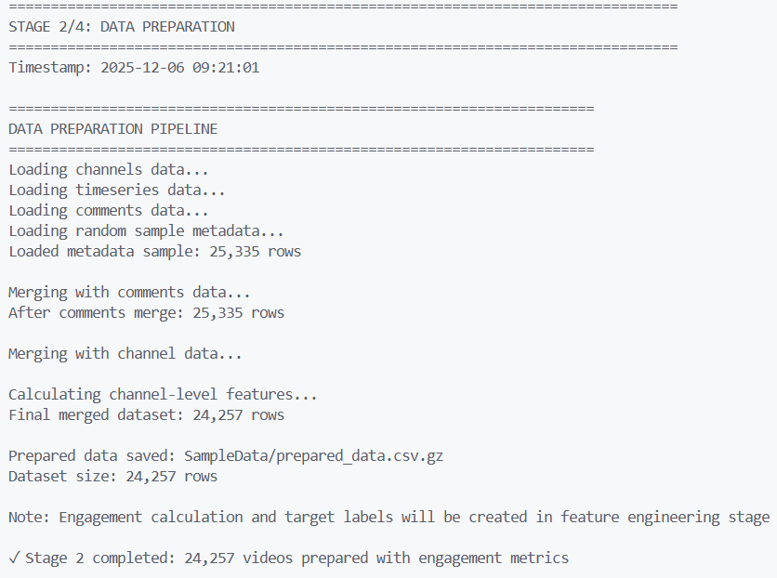
Notes:
Purpose: Merges data sources and prepares dataset for feature engineering. Does NOT create labels or engagement metrics to prevent data leakage.
Data Merging:
1. Merge metadata with comment counts (left join on `display_id`)
2. Merge with channel data (left join on `channel_id`)
3. Extract latest channel views from timeseries data
4. Calculate channel-level features

Slide 16
Step 3: Feature Engineering
Key Features:
Creates train/test split before label creation to prevent leakage
Labels created from training data percentile
Scales features using StandardScaler (fitted on training data only)
One-hot encoding done after split
Saves scaled datasets, preprocessing artifacts, and visualization plots
Engagement Metric:
engagement_per_day =
(like_rate - (0.5 * dislike_rate) + comment_rate) / days_since_upload
Notes:
Purpose: Calculates engagement metrics, extracts predictive features, creates train/test split with proper label creation, and applies scaling.
‘like_rate’, ‘dislike_rate’ and ‘comment_rate’ are normalized using ‘view_count’.
Feature Categories:
1. Video Metadata Features:
- Title: length, word count, questions, exclamations, uppercase ratio
- Description: length (log-transformed), word count (log-transformed), presence
- Tags: count
- Duration: categorical bins (short/long video flags)
2. Temporal Features:
- Upload: day of week (one-hot encoded)
- Filters: Removes videos uploaded before crawl or same-day
3. Channel Features:
- Average views per video (log-transformed)
- Subscriber to video ratio
4. Categorical Encodings:
- Category (one-hot encoding, excludes low-frequency categories)
- Day of week (one-hot encoding)
Data Leakage Prevention:
1. Split data with stratification on engagement scores
2. Calculate success threshold from TRAINING data percentile only
3. Apply same threshold to test data
4. One-hot encode categorical features separately for train/test
5. Fit scaler on training data, transform test data
Visualization Outputs:
- Target distribution plot (train vs test class balance)
- Feature distributions (histograms/bar charts for all features)
- Correlation heatmap (with highly correlated pairs identified)

Slide 17
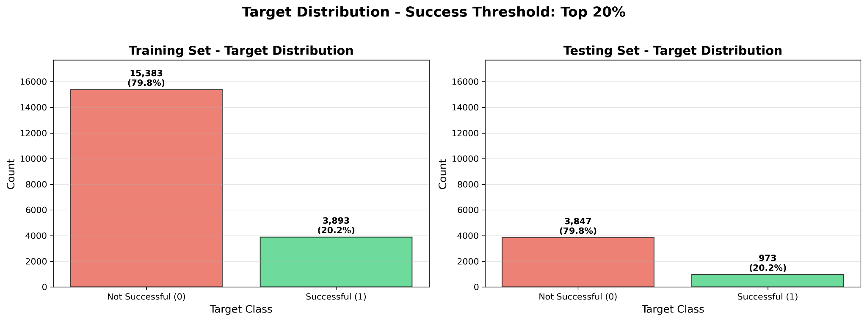
Figure: Target Distribution Plot Example
Notes:
Purpose: Calculates engagement metrics, extracts predictive features, creates train/test split with proper label creation, and applies scaling.
‘like_rate’, ‘dislike_rate’ and ‘comment_rate’ are normalized using ‘view_count’.

Slide 18
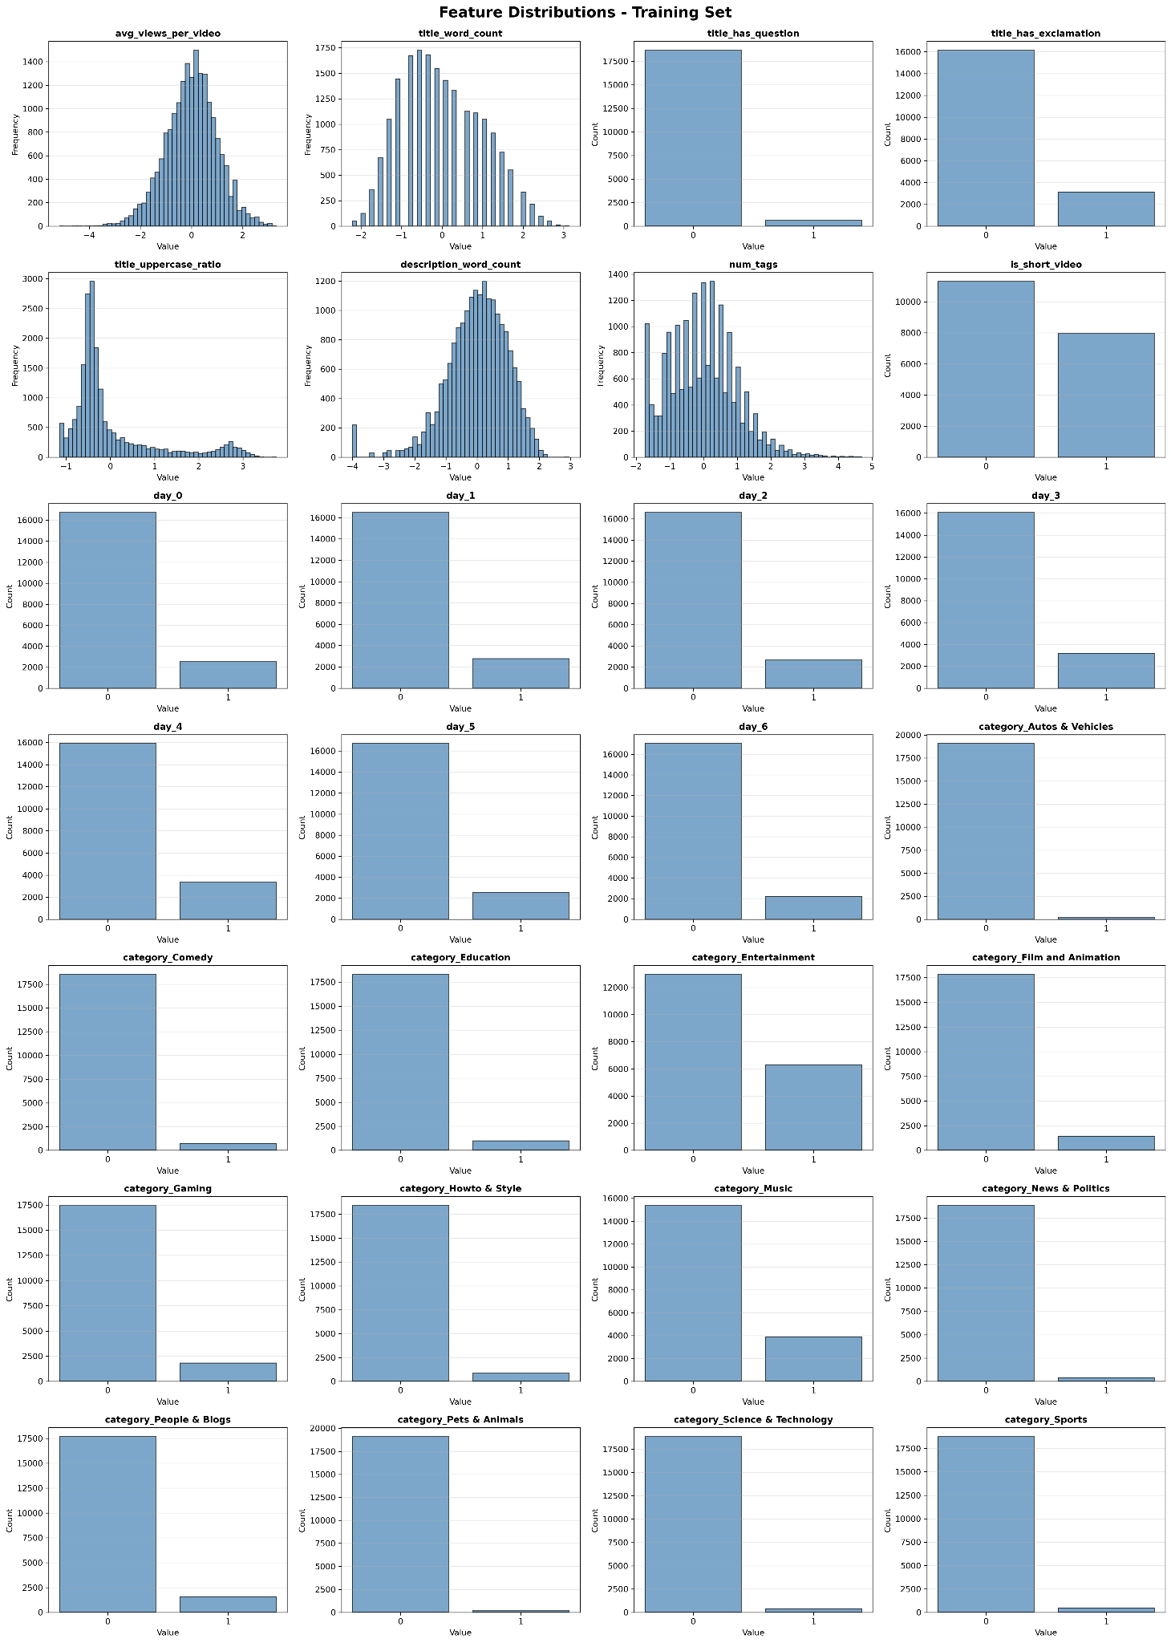
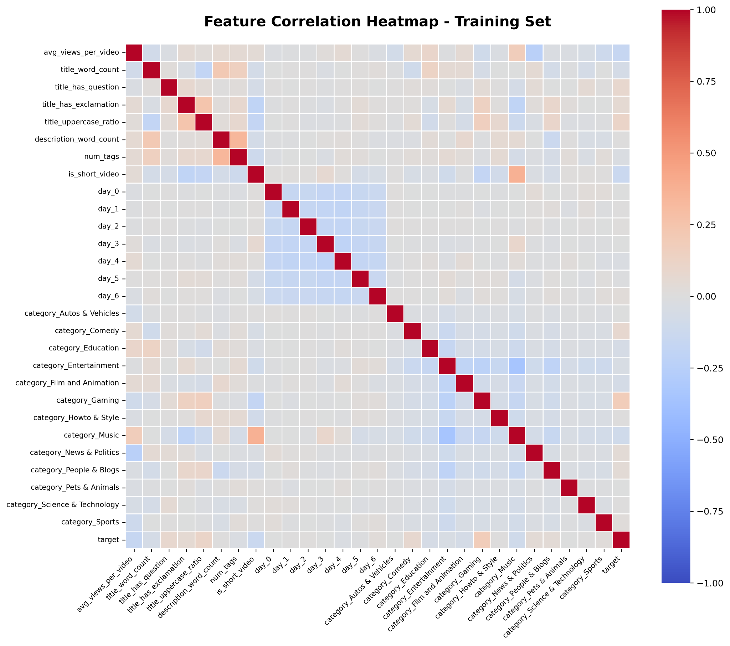
Figure: Feature Distribution Plots and Correlation Matrix Examples
Notes:
Purpose: Calculates engagement metrics, extracts predictive features, creates train/test split with proper label creation, and applies scaling.
‘like_rate’, ‘dislike_rate’ and ‘comment_rate’ are normalized using ‘view_count’.

Slide 19
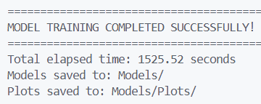
Step 4: Model Training
Key Features:
Loads pre-split datasets (X_train, X_test, y_train, y_test)
Uses pre-fitted scaler and pre-created labels
Focus on model training and hyperparameter optimization
Algorithms Used:
Random Forest Classifier
Decision Tree Classifier
Linear SVC
K-Nearest Neighbors
Multi-Layer Perceptron
Gradient Boosting Classifier
Logistic Regression
Hyperparameter Tuning:
Uses 5-fold cross-validation
Optimizes for precision score
Stores best parameters for each model
Notes:
Purpose: Trains multiple classification models with hyperparameter tuning using pre-split and pre-labeled data.
Evaluation Metrics:
- Accuracy, Precision, Recall, F1-score
- ROC-AUC score (when available)
- Classification report (per-class metrics)
- Confusion matrix

Slide 20
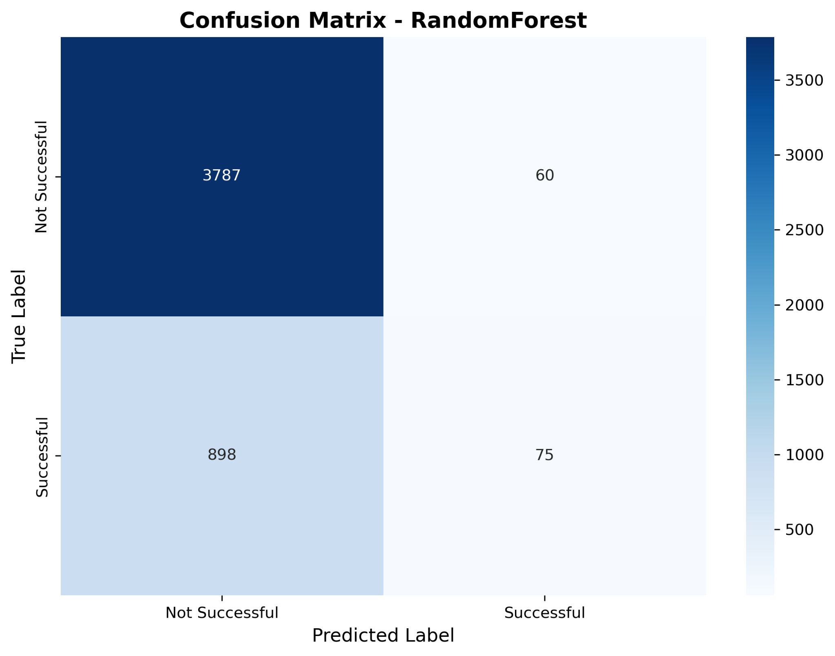
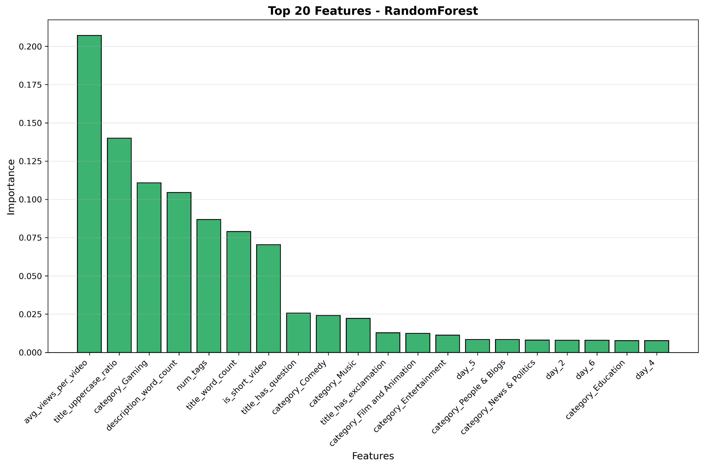
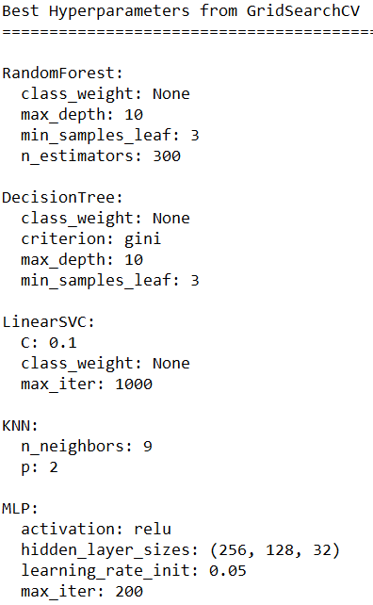
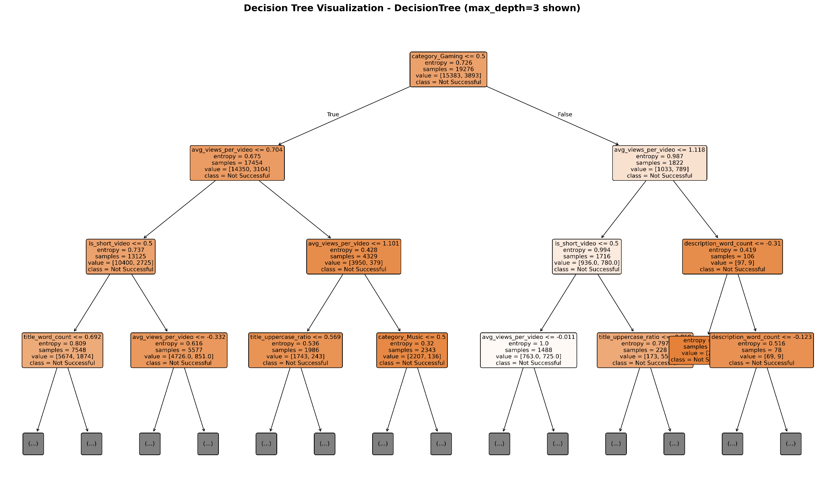
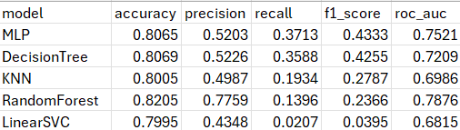

Slide 21
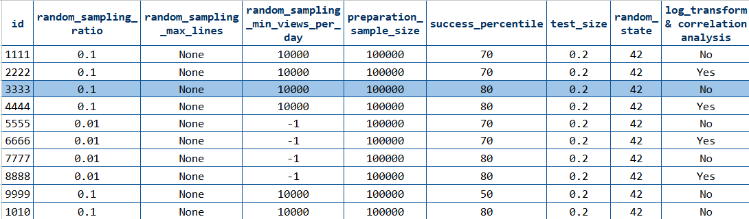
Execution and Evaluation

Slide 22
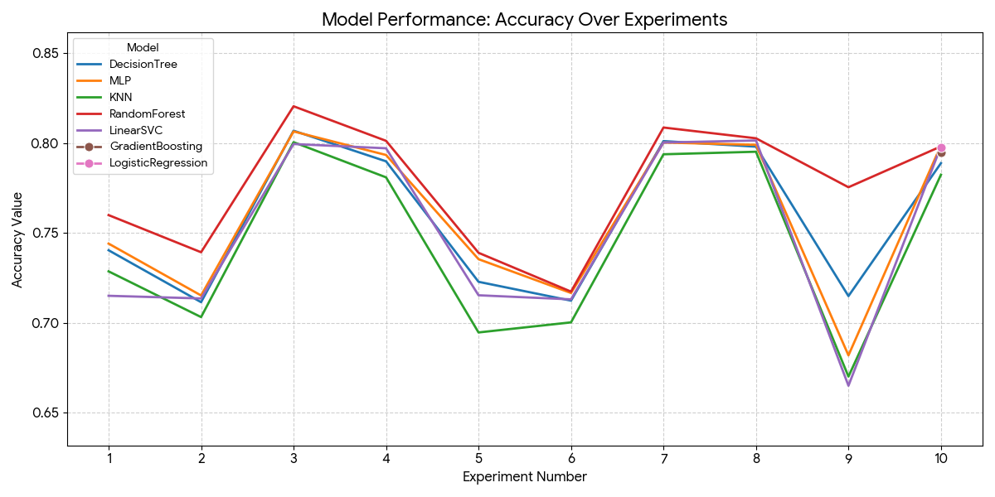
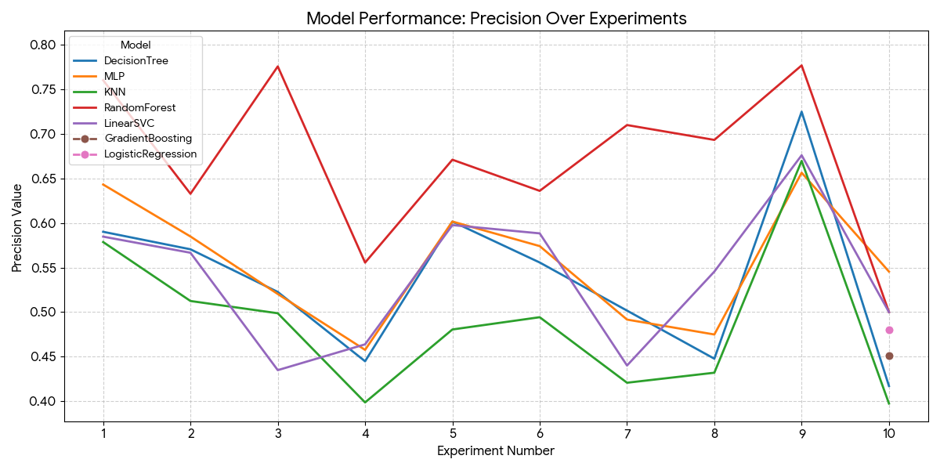
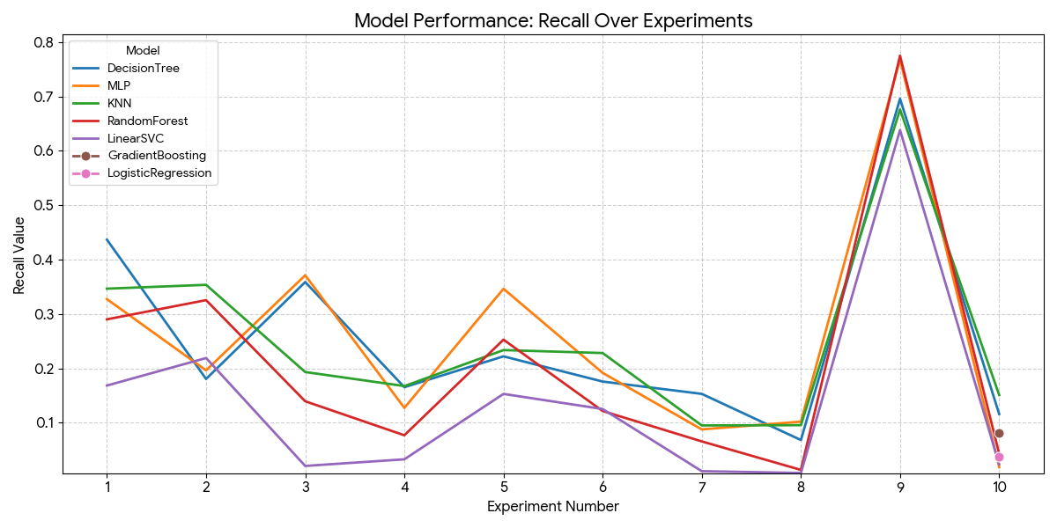

Slide 24

Best Model

Slide 25
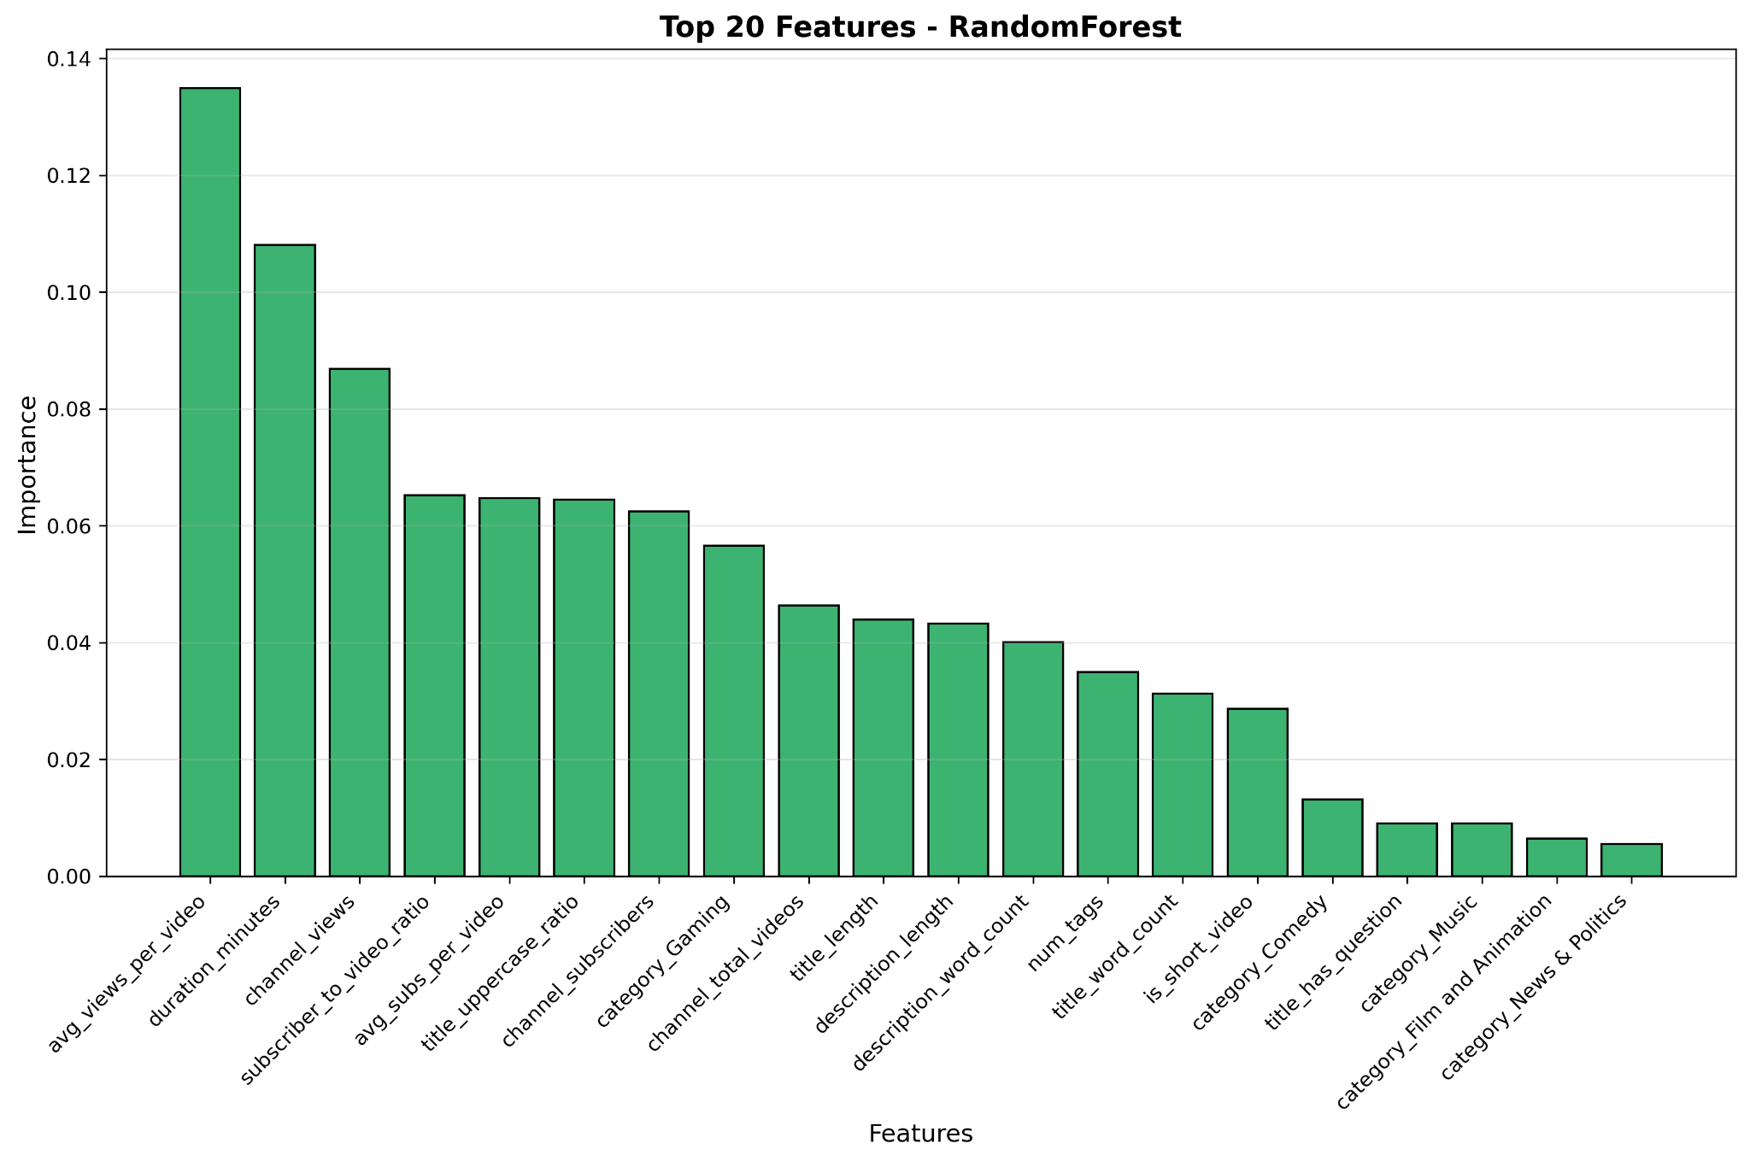
Best Model

Slide 26
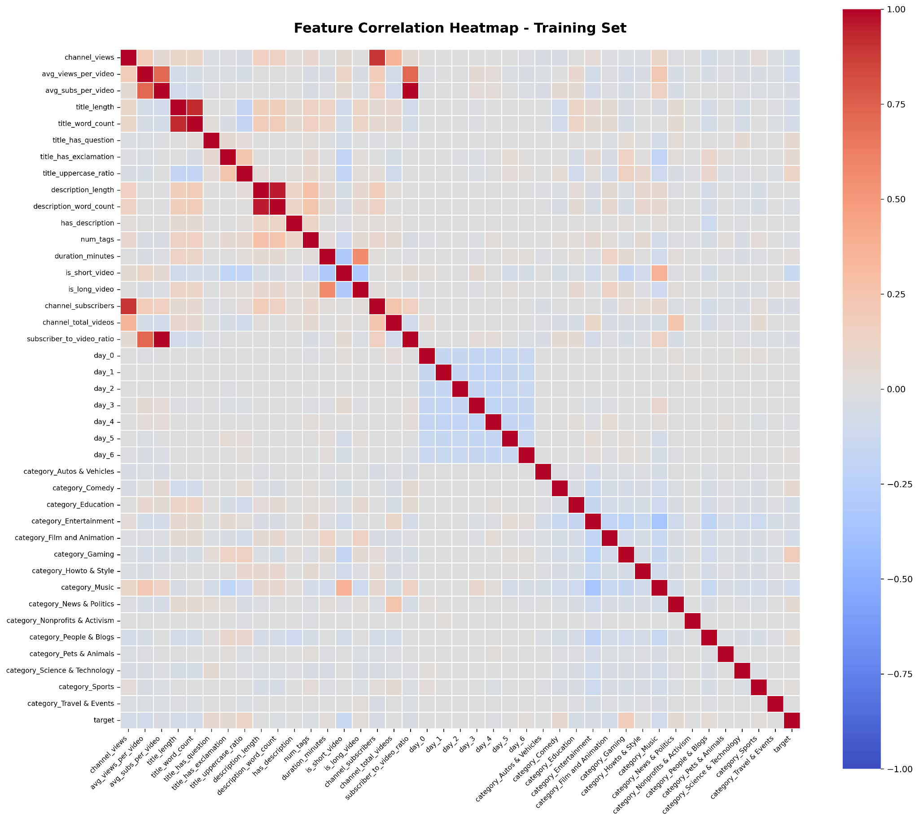

Slide 27
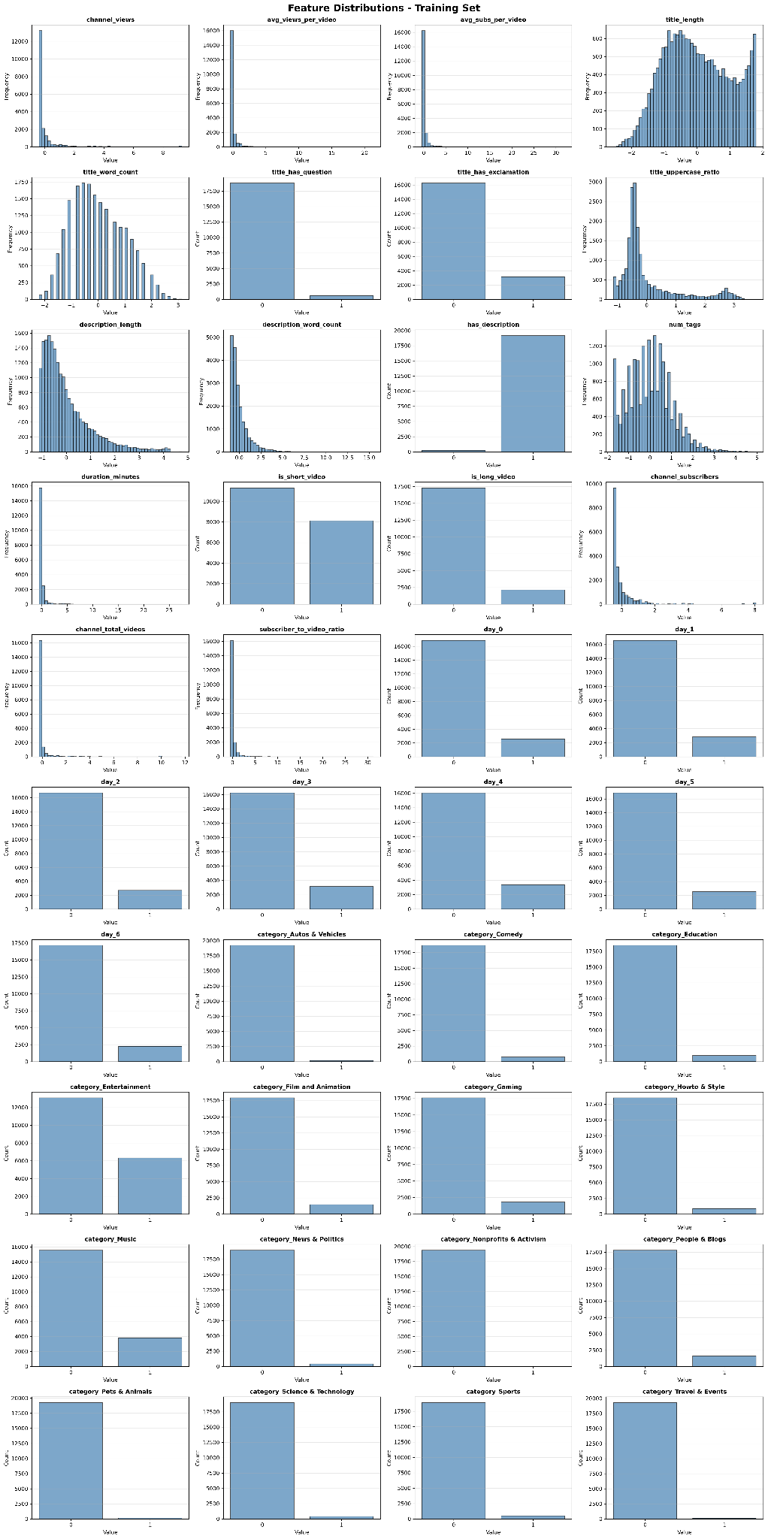

Slide 28
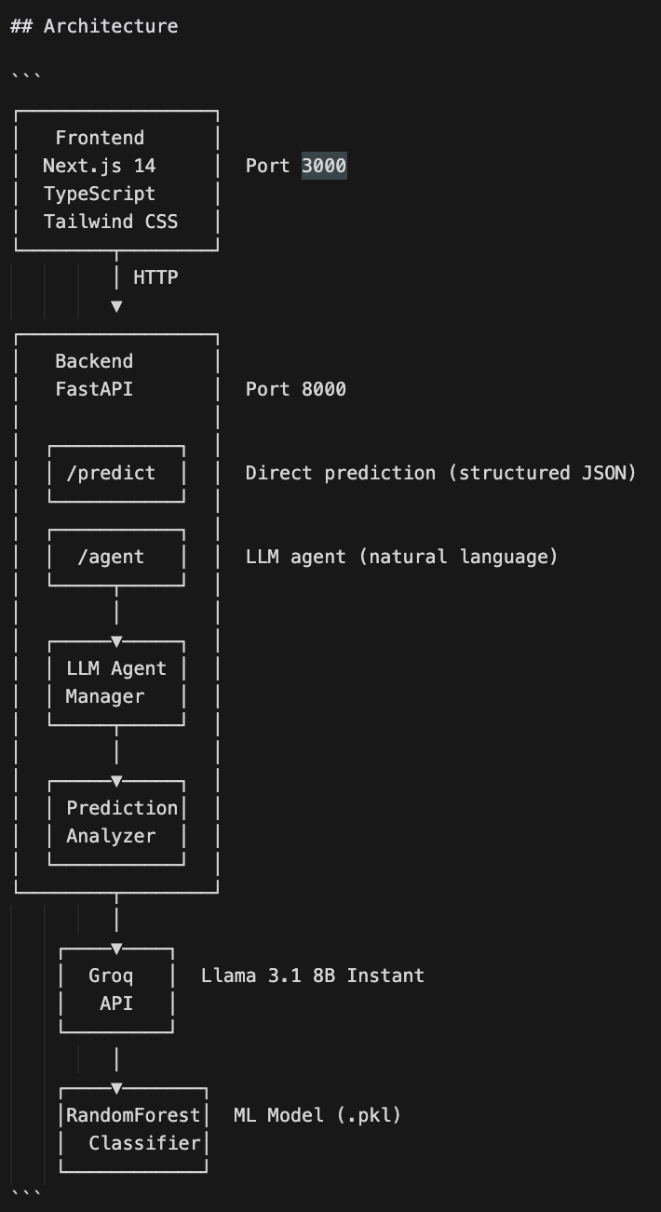
App Architecture
A full-stack application that predicts YouTube video performance using natural language input, LLM-powered feature extraction, and machine learning predictions.
Core Features - Natural Language Interface: Chat-based UI for describing videos in plain English - LLM-Powered Extraction: Groq API (Llama 3.1) extracts structured metadata from natural language - ML Predictions: RandomForest classifier predicts video success probability (0=failure, 1=success) - Conversational AI: Dual-mode agent - conversational responses or prediction analysis Prediction Mode: Triggered by keywords (predict, review) Conversational Mode: Default for general questions - LLM Analysis: AI-generated feedback and recommendations based on predictions

Slide 29


Demo
ViralScope Demo

Slide 30
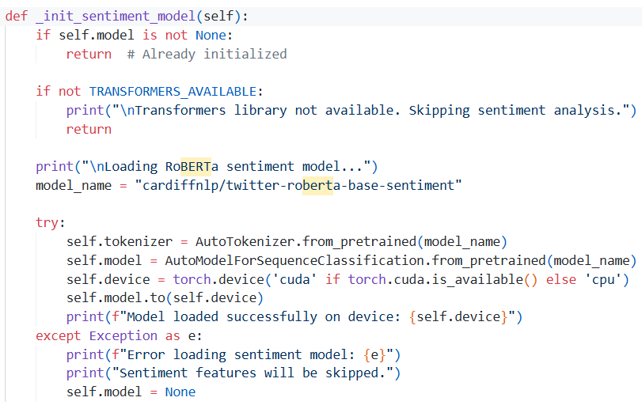
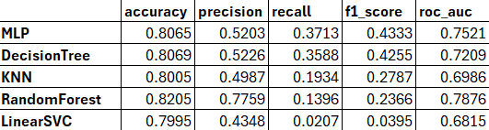
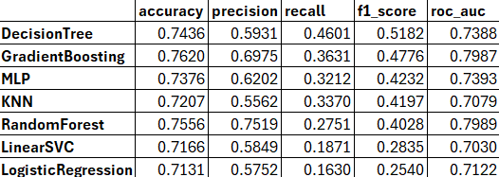
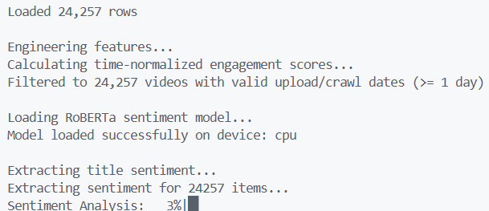
Sentiment Analysis

Slide 31
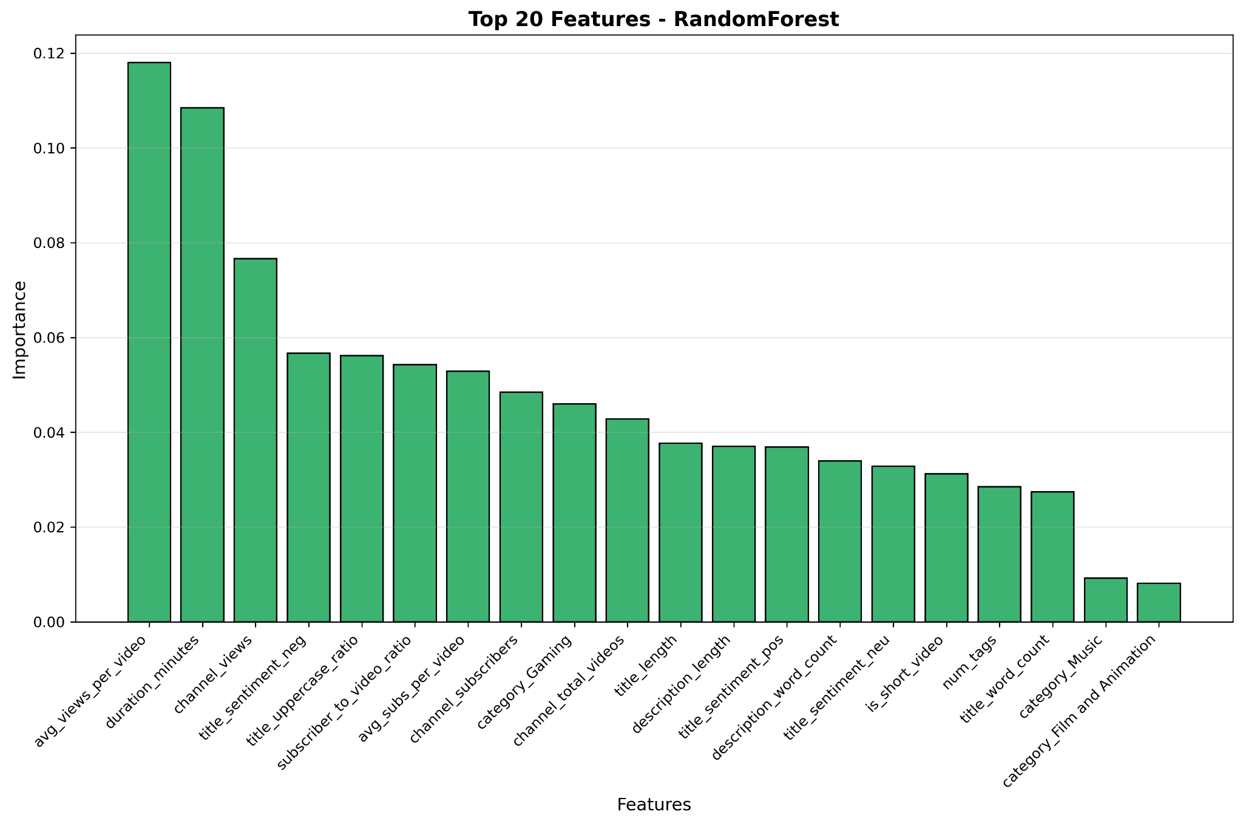
Sentiment Analysis

Slide 32
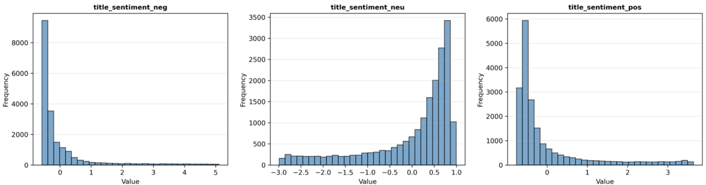
Sentiment Analysis

Slide 33
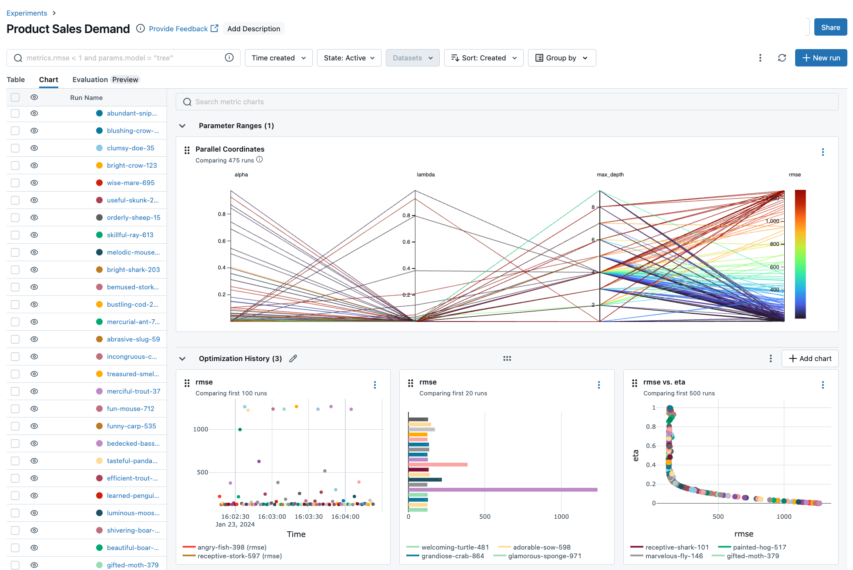
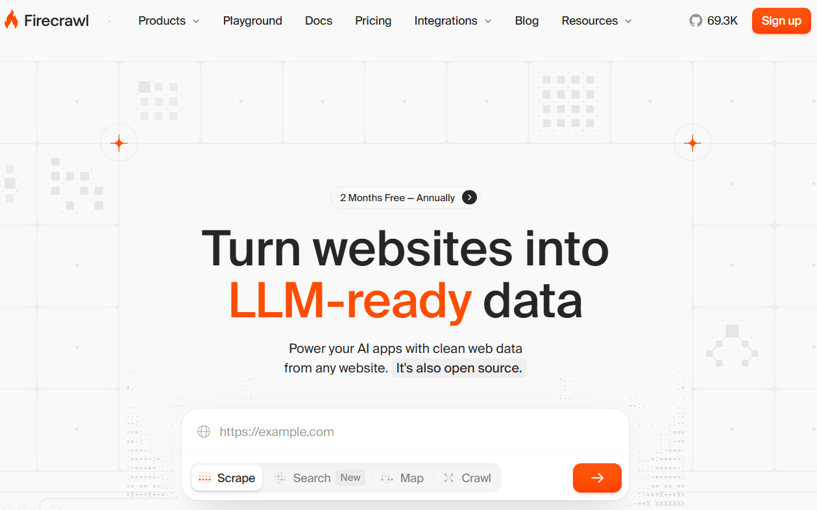
Future Work
Get recent data, set up a system for constant monitoring/crawling
Find similar videos using tags and similarity matrices
Experiment tracking with MLFlow
Notes:
MLflow is an application/framework that tracks ML experiments. It is used for hyperparameter tuning and performance tracking.

Slide 34
References and Documentation
Dataset: YouNiverse: Large-Scale Channel and Video Metadata
Paper: https://arxiv.org/pdf/2012.10378

Slide 35
Thank you!

